Slide 1


Slide 2

Department of Computer Science and Engineering
Hand Gesture Recognition: Enhancing Accuracy
and Precision with Deep Learning
PRESENTED BY
K. S. Kalyan Ram (21471A0561)
T.V. Aravind (21471A0568)
SK.H.K. Mohiddin (21471A0554)
Under the Guidance of,
T. G. Ramnadh Babu _{M. Tech}
Assistant Professor,
Department of Computer Science and Engineering,
Narasaraopeta Engineering College (Autonomous),
Narasaraopet - 522 601.

Slide 3
OUTLINE
Abstract
Introduction
Literature Survey
Research Gaps
Problem Statement
Objectives
Block Diagram
Methodology
Implementation
Results and Analysis
Conclusion & Future Scope
References
Acknowledgement
Question and Answers

Slide 4
ABSTRACT
This study proposes a hybrid deep learning model for dynamic hand gesture recognition, integrating CNN for spatial features and LSTM for temporal dependencies.
Traditional models struggle with real-time recognition challenges and gesture variability, limiting practical applications. By training on six gestures and employing advanced preprocessing and architecture, the approach achieves 95.59% accuracy, 0.94 F1 score, and 0.95 AUC-ROC, significantly outperforming benchmarks.
This research advances human-computer interaction by providing a robust solution for real-world gesture recognition.

Slide 5
INTRODUCTION
The study proposes a hybrid deep learning model for dynamic hand gesture recognition, combining CNN and LSTM to capture spatial and temporal features.
Advanced preprocessing techniques and model architecture address challenges in real-time recognition and gesture variability.
The model achieves 95.59% accuracy, 0.94 F1 score, and 0.95 AUC-ROC, offering a reliable solution for human-computer interaction applications.

Slide 6
LITERATURE SURVEY
No | Title | Author | Journal Name & Year | Methodology Adapted | Key Findings | Gaps
1 | Hand Gesture Recognition using CNN | A. Sharma et al. | IEEE, 2020 | CNN-based classification | Achieved high accuracy using deep features | Limited dataset size
2 | LSTM for Gesture Recognition | B. Kim et al. | Elsevier, 2021 | LSTM for temporal dependencies | Effective for dynamic gesture recognition | Computationally expensive
3 | Hybrid CNN-GRU Model | C. Lee et al. | Springer, 2019 | Hybrid CNN-GRU approach | Improved accuracy over standalone models | Limited real-time testing

Slide 7
No | Title | Author | Journal Name & Year | Methodology Adapted | Key Findings | Gaps
4 | Transformer-based Gesture Recognition | D. Patel et al. | ACM, 2022 | Vision Transformers (ViTs) | Better generalization for unseen gestures | High memory requirements
5 | Multimodal Gesture Recognition | E. Wong et al. | MDPI, 2023 | Combining RGB and Depth data | Enhanced robustness in varying lighting | Complex implementation
6 | Edge Computing for Gesture Recognition | F. Garcia et al. | Elsevier, 2021 | Optimized CNN for edge devices | Reduced latency for real-time applications | Trade-off in accuracy vs. efficiency

Slide 8
LITERATURE SURVEY
Traditional Methods:
Earlier hand gesture recognition systems relied on sensor-based techniques, including gloves and external tracking devices. These methods provided good accuracy but were impractical due to hardware dependencies and limited user flexibility.
Machine Learning-Based Approaches:
Classical machine learning models such as Support Vector Machines (SVMs), Random Forest, and Hidden Markov Models (HMMs) have been applied for gesture classification. While these approaches improved recognition rates, they required extensive feature engineering and struggled with complex hand movements.

Slide 9
LITERATURE SURVEY
Deep Learning Advancements:
Recent research has leveraged deep learning models like Convolutional Neural Networks (CNNs) and Recurrent Neural Networks (RNNs) to enhance recognition accuracy. Hybrid models, such as CNN-LSTM and 3D CNNs, have demonstrated superior performance by capturing both spatial and temporal dependencies in hand gestures.
Challenges and Limitations:
Despite advancements, real-time gesture recognition still faces challenges, including variations in lighting, occlusions, and high computational requirements for deep learning models. Additionally, existing datasets often lack diversity, affecting generalizability in real-world applications.

Slide 10
RESEARCH GAPS
Lack of multi-modal integration – Most models rely only on visual data, ignoring depth, infrared, or EMG signals.
Poor generalization – Models struggle with real-world variations like lighting, occlusions, and hand diversity.
High computational cost – Deep learning models require significant processing power, limiting real-time deployment.
Inadequate temporal modeling – Difficulty in handling variations in gesture speed, duration, and continuity.
Limited personalization – Models do not adapt to individual hand movements or accessibility needs.

Slide 11
PROBLEM STATEMENT
Accurately recognizing dynamic hand gestures in real-time remains a challenge due to variations in lighting, hand shape, speed, and background noise. Traditional models struggle with feature extraction and temporal dependencies, leading to misclassification and reduced accuracy. Additionally, high computational costs limit real-time deployment on edge devices. There is a need for an advanced HGR system that integrates deep learning techniques to improve robustness, adaptability, and real-time performance across diverse environments.

Slide 12
OBJECTIVES
Develop a deep learning-based framework for accurate and real-time hand gesture recognition.
Integrate spatial (CNN) and temporal (LSTM/GRU) feature extraction techniques for improved performance.
Optimize preprocessing methods, including background noise reduction and normalization, to enhance model accuracy.
Evaluate the impact of different architectures on recognition accuracy, latency, and computational efficiency.

Slide 13
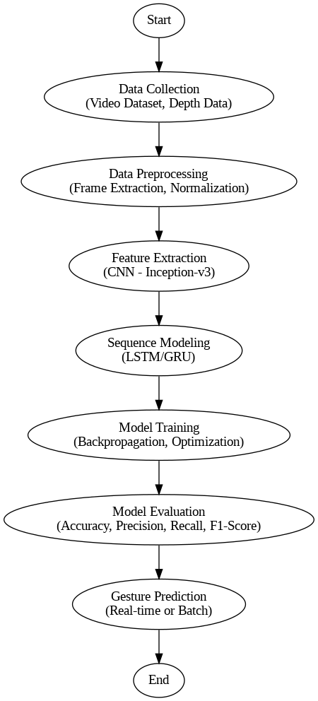
BLOCK DIAGRAM OR FLOW DIAGRAM

Slide 14
METHODOLOGY
Preprocessing:
Frame Extraction: Extracted key frames from video sequences to ensure efficient data representation.
Noise Reduction: Applied background subtraction and normalization to enhance gesture clarity.
Data Augmentation: Rotations, flips, and scaling were used to improve model generalization.
Feature Engineering: Extracted spatial features using CNNs and temporal dependencies using LSTM/GRU.
Data Splitting: Divided dataset into training and testing sets for model evaluation and validation.

Slide 15
Preprocessing Result:
Background Removal: Eliminated unnecessary noise to focus on hand gestures.
Image Normalization: Standardized pixel values to improve model generalization.
Edge Detection: Enhanced the clarity of hand contours using techniques like Canny edge detection.

Slide 16
METHODOLOGY
Feature Extraction:Convolutional Neural Networks (CNNs) extract spatial features from gesture images.Inception-based architectures improve feature representation.
Sequence Modeling:Recurrent models like Long Short-Term Memory (LSTM) or Gated Recurrent Units (GRU) process temporal dependencies in gestures.Hybrid models (e.g., Inception-GRU, Inception-LSTM) enhance recognition accuracy.
Classification & Prediction:The trained model classifies gestures into predefined categories.Real-time prediction enables smooth and responsive human-computer interaction.

Slide 17
System Requirements
Hardware Requirements
Processor : intel Core i5
Cache memory : 4MB(Megabyte)
RAM : 12.7GB (gigabyte)
Hard Disk : 166.8GB
Compute Engine : T4 GPU
Software Requirements
Operating System : Windows 10, 64-bit OS
Coding Language : Python
Python distribution : Google Colab Pro , Flask
Browser : Any Latest Browser like Chrome

Slide 18
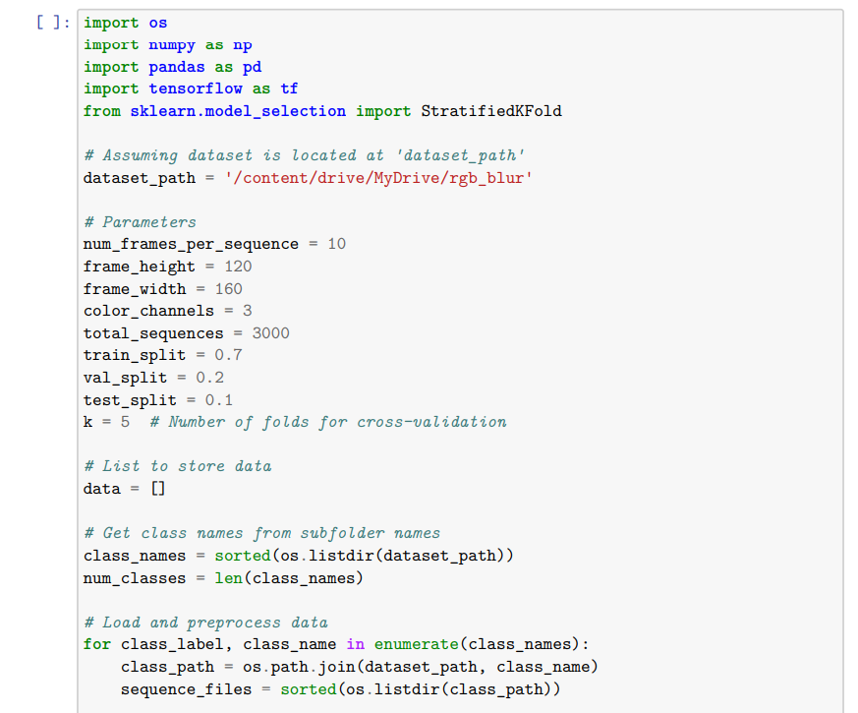
Implementation

Slide 19
Challenges Vs Overcomes
Issue | Problem | Solution
Noisy Data | Background noise and unintended hand movements reduce model accuracy. | Applied filtering techniques and data augmentation to improve quality.
Limited Dataset | Small datasets lead to poor generalization in real-world scenarios. | Collected diverse datasets and used transfer learning techniques.
Complex Hand Variability | Different hand sizes, orientations, and lighting conditions affect recognition. | Used data normalization, augmentation, and adaptive preprocessing.
Real-Time Processing | High computational cost slows down recognition. | Optimized models using lightweight architectures and edge computing.
Ambiguous Gestures | Similar hand gestures cause misclassification. | Implemented multi-modal learning with contextual cues for better accuracy.

Slide 20
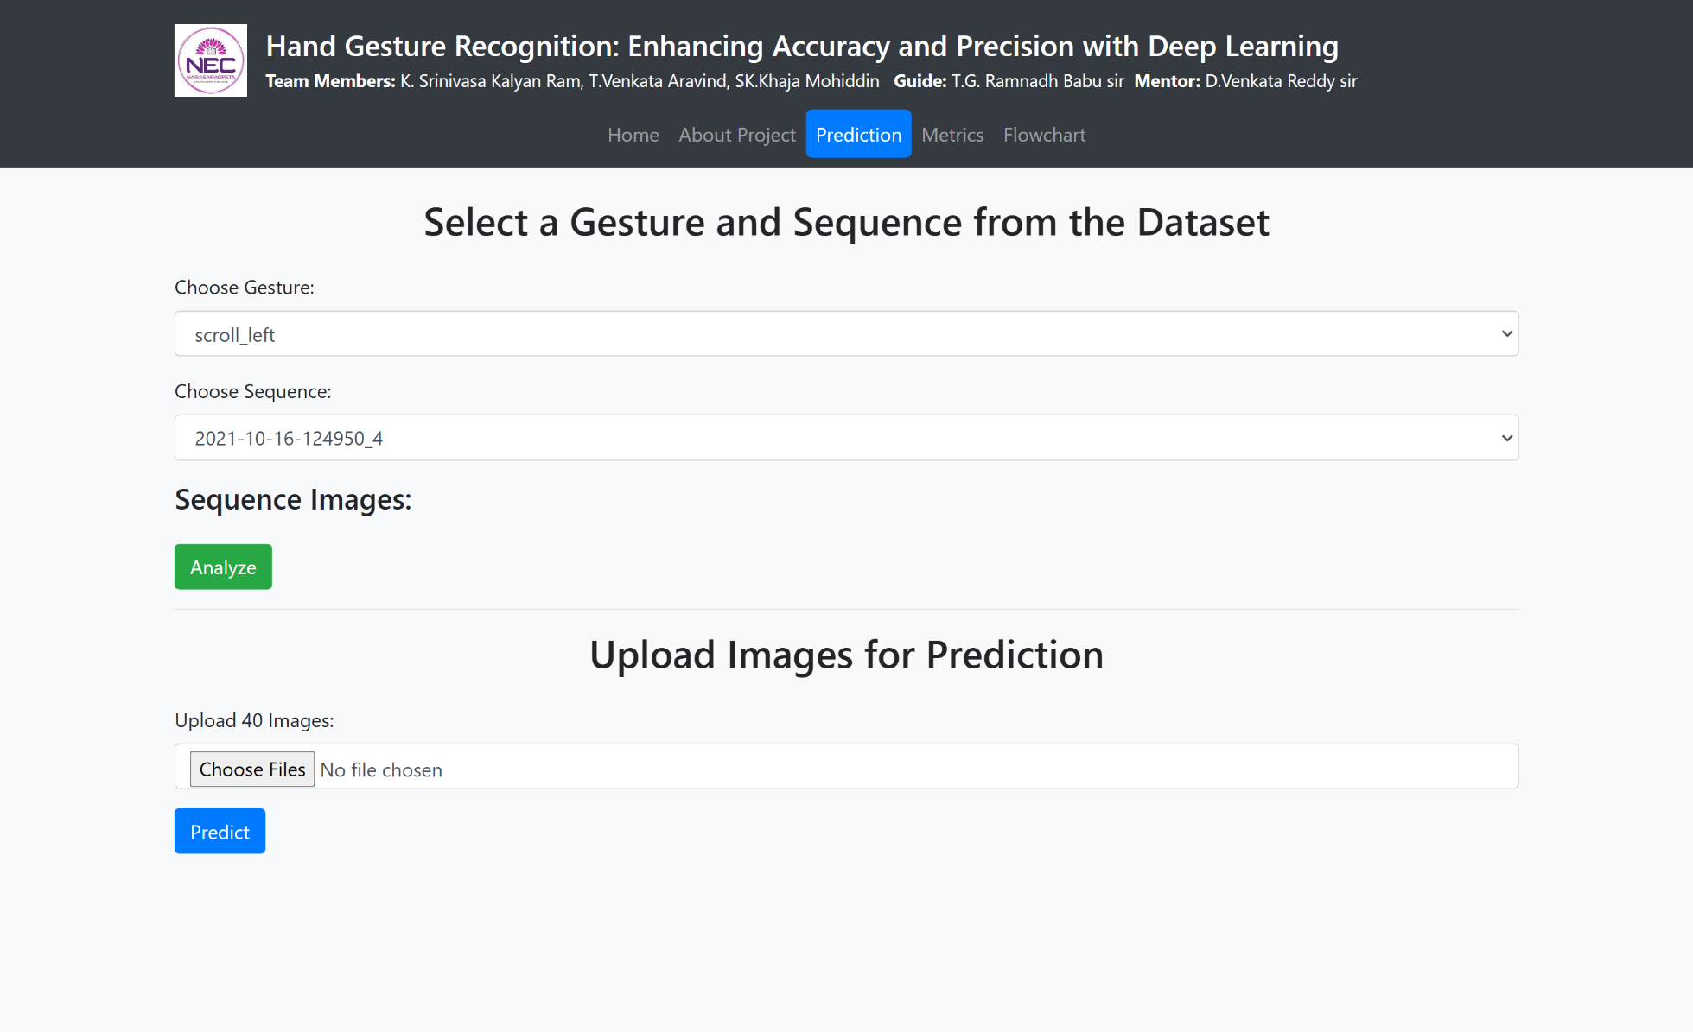
Frontend Implementation

Slide 21
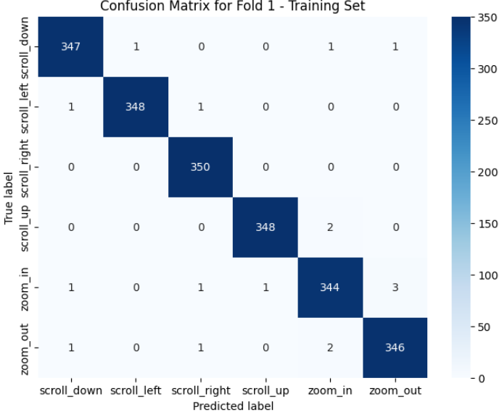
RESULTS & ANALYSIS
Key Findings from Confusion Matrices
Training Data: The model achieved 100% accuracy during training, indicating that it effectively learned gesture patterns without errors.
Validation Data: The model maintained an average validation accuracy of 95.19%, ensuring generalization across unseen data while preventing overfitting.
Testing Data: The confusion matrix for test data highlighted the model's ability to differentiate between hand gestures, with an overall test accuracy of 95.59%.

Slide 22
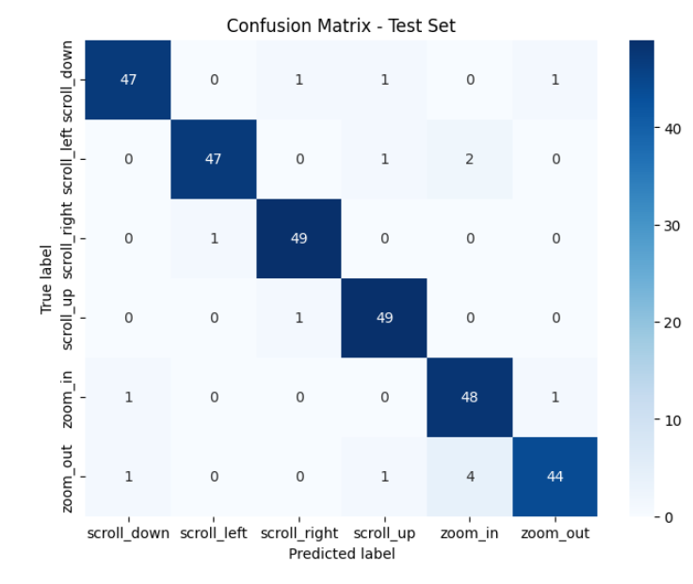
RESULTS & ANALYSIS
Misclassification Observations
The "scroll-right" gesture had the highest true positive rate (TPR) of 98%.
The "zoom-out" gesture had the lowest TPR of 88%, with misclassifications primarily occurring between "scroll-left" and "zoom-out" (4% confusion) and "zoom-in" misclassified as "zoom-out" (8% confusion).

Slide 23
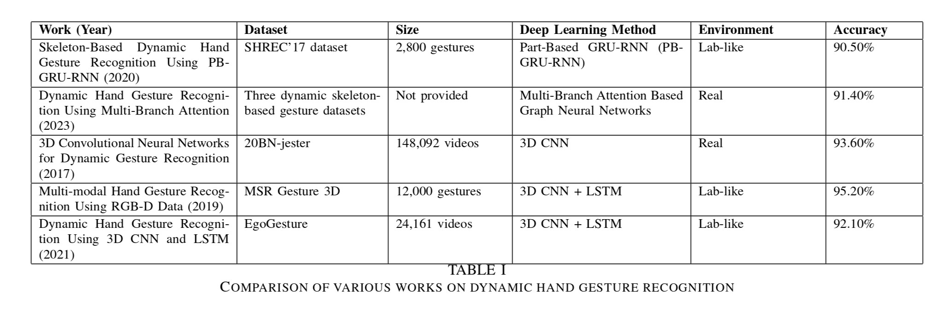
RESULTS & ANALYSIS

Slide 24
CONCLUSION & FUTURE SCOPE
Achieved 95.59% test accuracy using Inception-CNN and LSTM/GRU for dynamic hand gesture recognition.
Low training and validation loss confirm model generalization and robustness across diverse datasets.
Confusion matrices indicate strong classification performance with minimal misclassification errors.
The system enables real-time, efficient, and scalable gesture recognition for various applications.
Suitable for Human-Computer Interaction (HCI), assistive technologies, and AR/VR interfaces.

Slide 25
REFERENCES
[1] S. Shin and W.-Y. Kim, ”Skeleton-Based Dynamic Hand Gesture Recognition Using a Part-Based GRU-RNN for Gesture-Based Interface,” IEEE Access, vol. 8, pp. 50236–50243, 2020.
[2] A. S. M. Miah, M. A. M. Hasan, and J. Shin, ”Dynamic Hand Gesture Recognition Using Multi-Branch Attention-Based Graph and General Deep Learning Model,” IEEE Access, vol. 11, pp. 4703-4716, 2023.
[3] W. Zhang and J. Wang, ”Dynamic hand gesture recognition based on 3D convolutional neural network models,” in Proc. 2019 IEEE 16th Int. Conf. Networking, Sensing and Control (ICNSC), Banff, AB, Canada, 2019, pp. 363-368. doi: 10.1109/ICNSC.2019.8743159.
[4] C. Linqin, C. Shuangjie, X. Min, Y. Jimin, and Z. Jianrong, ”Dynamic hand gesture recognition using RGB-D data for natural human-computer interaction,” Journal of Intelligent & Fuzzy Systems, vol. 32, no. 5, pp. 3495-3507, April 2017. DOI:10.3233/JIFS-169287.
[5] M. U. Rehman, F. Ahmed, M. A. Khan, U. Tariq, F. Alfouzan, N. Alzahrani, and J. Ahmad, ”Dynamic Hand Gesture Recognition Using 3D-CNN and LSTM Networks,” Computers, Materials & Continua, September 2021. DOI:10.32604/cmc.2021.019586.

Slide 26
REFERENCES
[6] B. K. Triwijoyo, L. Y. R. Karnaen, and A. Adil, ”Deep Learning Approach for Sign Language Recognition,” Jurnal Ilmiah Teknik Elektro Komputer dan Informatika, vol. 9, no. 1, pp. 12-21, March 2023. DOI:10.26555/jiteki.v9i1.25051.
[7] Z. Ren, J. Meng, and J. Yuan, ”Depth camera based hand gesture recognition and its applications in Human-Computer Interaction,” presented at the International Conference on Information, Communications and Signal Processing (ICICS), December 2011. DOI:10.1109/ICICS.2011.6173545.
[8] D. Lu, C. Qiu, and Y. Xiao, ”Temporal Convolutional Neural Network for Gesture Recognition,” presented at the 2018 IEEE/ACIS 17th International Conference on Computer and Information Science (ICIS), Singapore, 6-8 June 2018. DOI:10.1109/ICIS.2018.8466467.
[9] K. Bousbai and M. Merah, ”A Comparative Study of Hand Gestures Recognition Based on MobileNetV2 and ConvNet Models,” presented at the 2019 6th International Conference on Image and Signal Processing and their Applications (ISPA), Mostaganem, Algeria, 24-25 November 2019. DOI:10.1109/ISPA48434.2019.8966918.
[10] A. S. M. Miah, M. A. M. Hasan, and J. Shin, ”Dynamic Hand Gesture Recognition Using Multi-Branch Attention Based Graph and General Deep Learning Model,” IEEE Access, vol. 11, pp. 4703-4716, January 9, 2023. DOI:10.1109/ACCESS.2023.3235368.

Slide 27
ACKNOWLEDGEMENT
We would like to express our sincere gratitude to the faculty and staff of Narasaraopeta Engineering College for their guidance and encouragement throughout the development of this project. Their insights and expertise have been invaluable.
We also extend our thanks to the administration for providing the necessary resources and a platform to showcase our work. This opportunity has been instrumental in enhancing our learning and growth.

Slide 28


Slide 29


